Slide 1
Memory Management

Slide 2
Contents
Introduction, Monoprogramming vs. Multi-programming, Modelling Multiprogramming, Multiprogramming with fixed and variable partitions, Relocation and Protection.
Memory management (Bitmaps & Linked-list), Memory Allocation Strategies
Virtual memory: Paging, Page Table, Page Table Structure, Handling Page Faults, TLB’s
Page Replacement Algorithms: FIFO, Second Chance, LRU, Optimal, LFU, Clock, WS-Clock, Concept of Locality of Reference, Belady’s Anomaly
Segmentation: Need of Segmentation, its Drawbacks, Segmentation with Paging (MULTICS)

Slide 3
Memory
Main memory (RAM) is an important resource that must be very carefully managed.
Basically every programmer or even normal computer programmer or user wants infinitely large and fast memory. And the memory is also non-volatile memory, means a memory that doesn't lose its content when the power supply stops.
The part of the OS that manages the memory hierarchy is called the memory manager.
Its job is to keep track of which parts of memory are in use and which parts are not in use.
To allocate memory to processes when they need it.
To deallocate it when they’re done.
To manage swapping between main memory and disk when main memory is too small to hold all the processes.

Slide 4
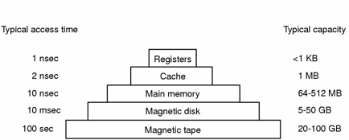
Computer Hardware Review
Typical memory hierarchy
– numbers shown are rough approximations
4

Slide 5
Memory management systems can be divided into two basic classes:
Those that move processes back and forth between main memory and disk during execution (swapping and paging) and
Those that don’t.

Slide 6
Monoprogramming without Swapping or Paging
The simplest possible memory management scheme is to run just one program at a time, sharing the memory between that program and the OS.
Three simple ways of organizing memory
-An operating system with one user process,
Figure 5-1: Three simple ways of organizing memory with an operating system and one user process. Other possibilities also exist.

Slide 7
The OS may be at the bottom of memory in RAM (a). Or it may be in ROM at the top of memory (b) or the device drivers may be at the top of memory in a ROM and the rest of the system in RAM down below (c).
The first model was formerly used on mainframes and minicomputers but is rarely used any more.
The second model is used on some palmtop computers and embedded systems.
The third model was used by early personal computers (e.g., running MS-DOS), where the portion of the system in the ROM is called the BIOS.
When the system is organized in this way, only one process at a time can be running.
As soon as the user types a command, the OS copies the requested program from disk to memory and executes it.
When the process finishes, the OS displays a prompt character and waits for a new command.
When it receives the command, it loads a new program into memory, overwriting the first one.

Slide 8
Multiprogramming
Today, almost all computer systems allow multiple processes to run at the same time.
When multiple processes running at the same time, means that when one process is blocked waiting for input/output to finish, another one can use the Central Processing Unit.
Therefore, multiprogramming increases the central processing unit utilization.
Now-a-day, both network server and client machines have the ability to run multiple processes at the same time.
To achieve multiprogramming, the simplest way is just to divide memory up into n partitions (normally unequal partitions).
Multiprogramming lets the processes use the Central Processing Unit when it would be. The Central Processing Unit (CPU) utilization can be improved when multiprogramming is used.

Slide 9
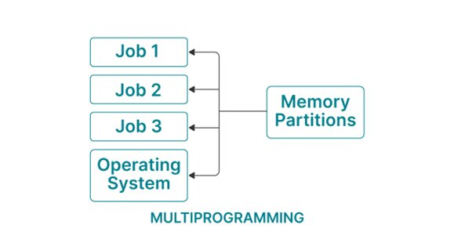

Slide 10
Logical and Physical Address
Logical Address
Address generated by CPU while a program is running is referred as Logical Address.
The logical address is virtual as it does not exist physically. Hence, it is also called as Virtual Address. This address is used as a reference to access the physical memory location.
The set of all logical addresses generated by a programs perspective is called Logical Address Space.
The logical address is mapped to its corresponding physical address by a hardware device called Memory-Management Unit. The address-binding methods used by MMU generates identical logical and physical address during compile time and load time.

Slide 11
Physical Address
Physical Address identifies a physical location in a memory.
MMU (Memory-Management Unit) computes the physical address for the corresponding logical address. MMU also uses logical address computing physical address. The user never deals with the physical address.
The logical address is mapped to the physical address using a hardware called Memory-Management Unit.
The set of all physical addresses corresponding to the logical addresses in a Logical address space is called Physical Address Space.

Slide 12
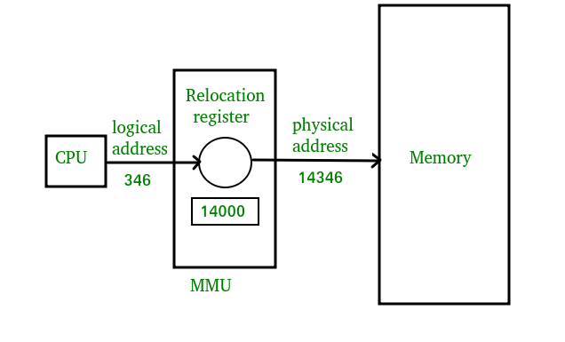

Slide 13
Differences Between Logical and Physical Address in Operating System
The basic difference between Logical and physical address is that Logical address is generated by CPU in perspective of a program whereas the physical address is a location that exists in the memory unit.
Logical Address Space is the set of all logical addresses generated by CPU for a program whereas the set of all physical address mapped to corresponding logical addresses is called Physical Address Space.
The logical address does not exist physically in the memory whereas physical address is a location in the memory that can be accessed physically.
Identical logical addresses are generated by Compile-time and Load time address binding methods whereas they differs from each other in run-time address binding method. Please refer this for details.
The logical address is generated by the CPU while the program is running whereas the physical address is computed by the Memory Management Unit (MMU).

Slide 14
Swapping
Swapping is a memory management scheme in which any process can be temporarily swapped from main memory to secondary memory so that the main memory can be made available for other processes. It is used to improve main memory utilization.
A swapping allows more processes to be run and can be fit into memory at one time. The main part of swapping is transferred time and the total time directly proportional to the amount of memory swapped. Swapping is also known as roll-out, roll in, because if a higher priority process arrives and wants service, the memory manager can swap out the lower priority process and then load and execute the higher priority process.

Slide 15
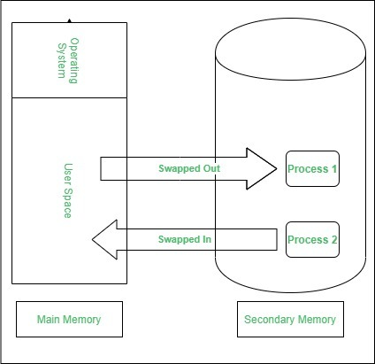

Slide 16
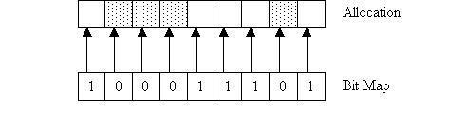
Memory Management with Bitmaps
Under this scheme the memory is divided into allocation units and each allocation unit has a corresponding bit in a bit map. If the bit is zero, the memory is free. If the bit in the bit map is one, then the memory is currently being used.
The main decision with this scheme is the size of the allocation unit. The smaller the allocation unit, the larger the bit map has to be. But, if we choose a larger allocation unit, we could waste memory as we may not use all the space allocated in each allocation unit.

Slide 17
Memory Usage with Linked Lists
Free and allocated memory can be represented as a linked list. The memory shown above as a bit map can be represented as a linked list as follows.
Each entry in the list holds the following data
· P or H : for Process or Hole · Starting segment address · The length of the memory segment · The next pointer is not shown but assumed to be present
In the list above, processes follow holes and vice versa (with the exception of the start and the end of the list). But, it does not have to be this way. It is possible that two processes can be next to each other and we need to keep them as separate elements in the list so that if one process ends we only return the memory for that process.

Slide 18
Contiguous and Noncontiguous memory allocation
Contiguous memory allocation | Noncontiguous memory allocation
Program execution takes place without the overhead. | Address translation is overhead.
Swapped-in processes are placed in the original area. | Swapped-in processes can be placed anywhere in memory.
Suffer from exteral fragmentation. | Only paging suffers from internal fragmentation.
Allocates a single area of memory for the process. | Allocates more than one block of memory for the process.
Wastage of memory | No wastage of memory.
Fixed-sized partition, variable partition | Paging, multi-level paging, inverted paging and segmentation

Slide 19
Memory Management Techniques
Before details about moving processes out
-Assign memory to processes
Memory partitioning
Fixed partitioning
Dynamic partitioning
Simple paging
Simple segmentation
Virtual memory paging
Virtual memory segmentation

Slide 20
Memory Allocation
Multiprogramming with Fixed Partitions
Except on very simple embedded systems, monoprogramming is hardly used any more.
Most modern systems allow multiple processes to run at the same time.
Having multiple processes running at once means that when one process is blocked waiting for I/O to finish, another one can use the CPU.
–Multiprogramming increases the CPU utilization.
The easiest way to achieve multiprogramming is simply to divide memory up into n (possibly unequal) partitions.
This partitioning can, for example, be done manually when the system is started up.

Slide 21
Figure 5-2. (a) Fixed memory partitions with separate input queues for each partition.(b) Fixed memory partitions with a single input queue.

Slide 22
In figure (a) we see how this system of fixed partitions and separate input queues look.
–The disadvantage of sorting the incoming jobs into separate queues becomes apparent when the queue for a large partition is empty but the queue for a small partition is full, as is the case for partitions 1 & 4 in (a).
An alternative organization is to maintain a single queue as in (b).
–Whenever a partition becomes free, the job closest to the front of the queue that fits in it could be loaded into the empty partition and run.
–Since it’s undesirable to waste a large partition on a small job, a different strategy is to search the whole input queue whenever a partition becomes free and pick the largest job that

Slide 23
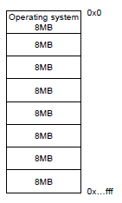
Two fixed partitioning schemes
-Equal-size partitions
-Unequal-size partitions
Equal-size partitions
Big programs can not be executed
-Unless program parts are loaded from disk
Small programs use entire partition
-A problem called “internal fragmentation”

Slide 24
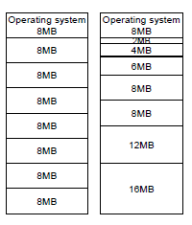
Unequal-size partitions
Bigger programs can be loaded at once
Smaller programs can lead to less internal fragmentation
Advantages require assignment of jobs to partitions

Slide 25
Advantages of Fixed Partitioning
Easy to implement: Algorithms needed to implement Fixed Partitioning are easy to implement. It simply requires putting a process into a certain partition without focusing on the emergence of Internal and External Fragmentation.
Little OS overhead: Processing of Fixed Partitioning requires lesser excess and indirect computational power.
Disadvantages of Fixed Partitioning
Internal Fragmentation:
External Fragmentation:
Limit process size:
Limitation on Degree of Multiprogramming:

Slide 26
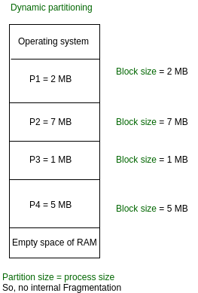
Variable Partitioning
It is a part of Contiguous allocation technique. It is used to alleviate the problem faced by Fixed Partitioning. In contrast with fixed partitioning, partitions are not made before the execution or during system configure.
Initially RAM is empty and partitions are made during the run-time according to process’s need instead of partitioning during system configure.
The size of partition will be equal to incoming process.
The partition size varies according to the need of the process so that the internal fragmentation can be avoided to ensure efficient utilisation of RAM.
Number of partitions in RAM is not fixed and depends on the number of incoming process and Main Memory’s size.

Slide 27
Advantages of Variable Partitioning
No Internal Fragmentation: In variable Partitioning, space in main memory is allocated strictly according to the need of process, hence there is no case of internal fragmentation. There will be no unused space left in the partition.
No restriction on Degree of Multiprogramming: More number of processes can be accommodated due to absence of internal fragmentation. A process can be loaded until the memory is empty.
No Limitation on the size of the process: In Fixed partitioning, the process with the size greater than the size of the largest partition could not be loaded and process can not be divided as it is invalid in contiguous allocation technique. Here, In variable partitioning, the process size can’t be restricted since the partition size is decided according to the process size.
Disadvantages of variable partition
Difficult to implement

Slide 28
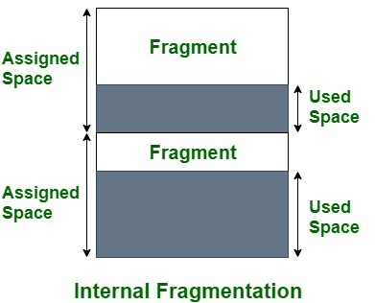
Fragmentation
As processes are loaded and removed from memory, the free memory space is broken into little pieces. It happens after sometimes that processes cannot be allocated to memory blocks considering their small size and memory blocks remains unused. This problem is known as Fragmentation.
Internal Fragmentation:
Internal fragmentation happens when the memory is split into mounted-sized blocks. Whenever a method is requested for the memory, the mounted-sized block is allotted to the method. just in case the memory allotted to the method is somewhat larger than the memory requested, then the distinction between allotted and requested memory is that the internal fragmentation.

Slide 29
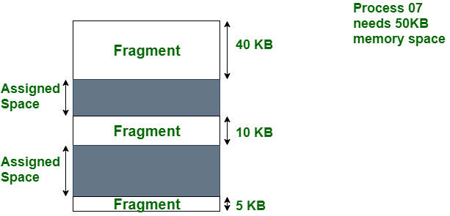
Fragmentation
External Fragmentation:
External fragmentation happens when there’s a sufficient quantity of area within the memory to satisfy the memory request of a method. However, the process’s memory request cannot be fulfilled because the memory offered is in a non-contiguous manner. Whether you apply a first-fit or best-fit memory allocation strategy it’ll cause external fragmentation.

Slide 30
Requirements of Memory management
Relocation and Protection
The term program re-locatability refers to the ability to load and execute a given program into memory.
Memory management technique in which system stores and retrieves data from secondary storage for use in main memory is called paging technique in memory management.
In reality, the program may be loaded at different memory locations, which are called physical addresses.
Relocation is way to map virtual addresses into physical addresses.
Depending on when and how the mapping from the virtual address space to the physical address space takes place in a given relocation scheme.

Slide 31
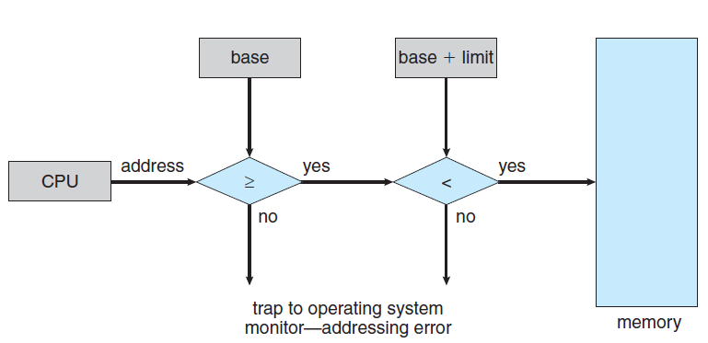
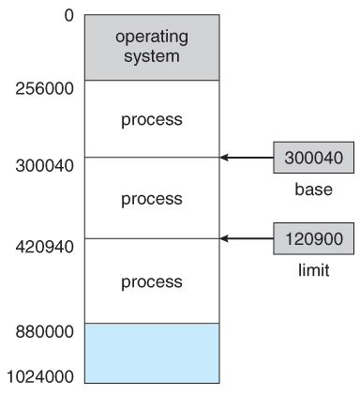
A pair of base and limit registers define the logical address space
Figure 5-3 : A base and a limit register define a logical address space
Figure 5-4 : Hardware Address Protection

Slide 32
Addresses are also checked against the limit register to make sure that they do not attempt to address memory outside the current partition.
The hardware protects the base and limit registers to prevent user programs from modifying them.
A disadvantage of relocation using base and limit registers is the need to perform an addition and a comparison on every memory reference. Comparisons can be done fast, but additions are slow due to carry-propagation time unless special addition circuits are used.
Few computers use it now.

Slide 33
Compaction
Compaction is a process in which the free space is collected in a large memory chunk to make some space available for processes.
In memory management, swapping creates multiple fragments in the memory because of the processes moving in and out.
Compaction refers to combining all the empty spaces together and processes.
Compaction helps to solve the problem of fragmentation, but it requires too much of CPU time.
It moves all the occupied areas of store to one end and leaves one large free space for incoming jobs, instead of numerous small ones.
In compaction, the system also maintains relocation information and it must be performed on each new allocation of job to the memory or completion of job from memory.

Slide 34
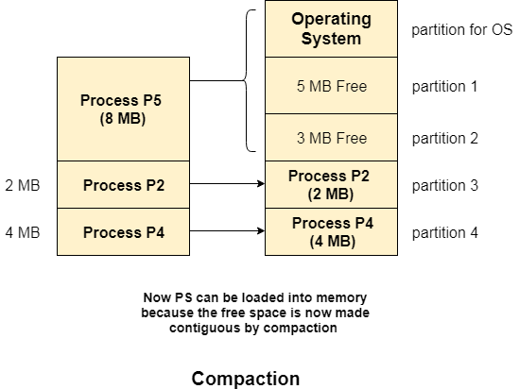
Compaction

Slide 35
Memory Protection
Memory protection implemented
– by associating protection bit with each frame
– to indicate if read-only or read-write access is allowed
– Can also add more bits to indicate page execute-only, and so on
Valid-invalid bit attached to each entry in the page table:
When this bit is set to "valid," the associated page is in the process's logical address space and is thus a legal (or valid) page.
When the bit is set to "invalid," the page is not in the process's logical address space. Illegal addresses are trapped by use of the valid -invalid bit.

Slide 36
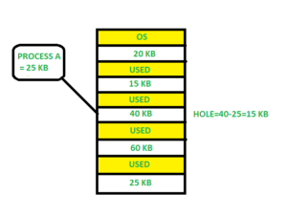
Memory Allocation Strategies
First fit
The process manager scans along the list of segments until it finds a hole that is big enough.
The hole is then broken up into two pieces, one for the process and one for the unused memory, except in the statistically unlikely case of an exact fit.
First fit is a fast algorithm because it searches as little as possible.

Slide 37
Memory Allocation Strategies
Next fit
It works the same way as first fit, except that it keeps track of where it is whenever it finds a suitable hole.
The next time it is called to find a hole, it starts searching the list from the place where it left off last time, instead of always beginning, as first fit does.

Slide 38
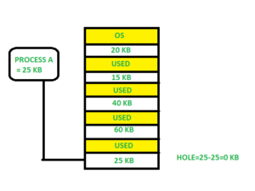
Best fit
Best fit searches the entire list and takes the smallest hole that is adequate.
Rather than breaking up a big hole that might be needed later, best fit tries to find a hole that is close to the actual size needed.
Best fit is slower that first fit because it must search the entire list every time it is called.

Slide 39
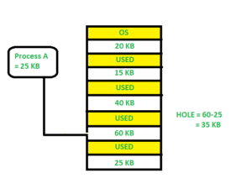
worst fit
To get around the problem of breaking up nearly exact matches into a process and a tiny hole, one could think about worst fit, that is, always take the largest available hole, so that the hole broken off will be big enough to be useful.
Simulation has shown that worst fit is not a very good idea either.

Slide 40
Quick fit
Quick fit maintains separate lists for some of the more common sizes requested.
For example, it might have a table with n entries, in which the first entry is a pointer to the head of a list of 4-kb holes, the second entry is a pointer to a list of 8-kb holes, the third entry a pointer to 12-kb holes, and so on.
Holes of say, 21-kb, could either be put on the 20-kb list or on a special list of odd-sized holes.
With quick fit, finding a hole of the required size is extremely fast, but it has the same disadvantage as all the other scheme that sort by hole size.

Slide 41
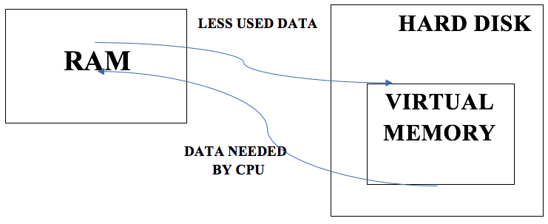
Virtual Memory
Virtual Memory is a storage scheme that provides user an illusion of having a very big main memory. This is done by treating a part of secondary memory as the main memory.
In this scheme, User can load the bigger size processes than the available main memory by having the illusion that the memory is available to load the process.
Instead of loading one big process in the main memory, the Operating System loads the different parts of more than one process in the main memory.
By doing this, the degree of multiprogramming will be increased and therefore, the CPU utilization will also be increased.

Slide 42
The method that was devised has come to be known as virtual memory. The basic idea behind virtual memory is that each program has its own address space, which is broken up into chunks called pages.
Virtual memory, or virtual storage is a memory management technique that provides an "idealized abstraction of the storage resources that are actually available on a given machine" which "creates the illusion to users of a very large memory".
These pages are mapped onto physical memory, but not all pages have to be in physical memory at the same time to run the program.

Slide 43
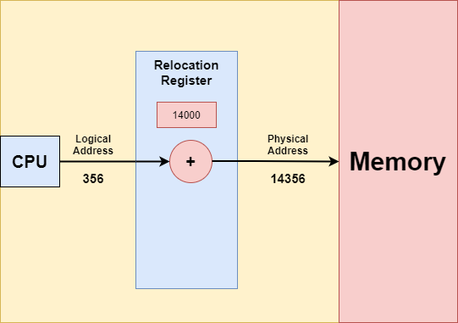
Logical and Physical Address Space in Operating Systems
The address that is generated by the CPU is commonly referred to as the Logical Address. It is basically a virtual address. The logical address is basically the address of an instruction or data used by any program.
The set of all logical addresses that are generated by any program is referred to as Logical Address Space.
In the above diagram, the base register is termed the Relocation register. The relocation register is a special register in the CPU and is used for the mapping of logical addresses used by a program to physical addresses of the system's main memory.

Slide 44
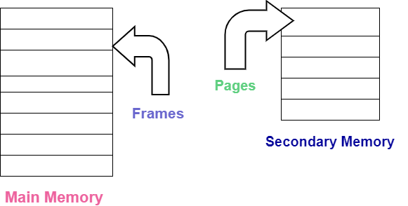
Paging
Paging is a memory management scheme that eliminates the need for contiguous allocation of physical memory. This scheme permits the physical address space of a process to be non – contiguous.
Paging helps to avoid external fragmentation and the need for compaction.
The paging technique divides the physical memory(main memory) into fixed-size blocks that are known as Frames and also divide the logical memory(secondary memory) into blocks of the same size that are known as Pages.

Slide 45
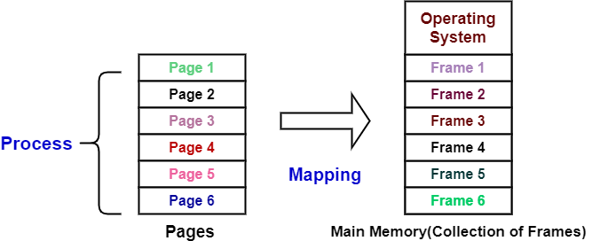
paging
Pages of a process are brought into the main memory only when there is a requirement otherwise they reside in the secondary storage.
One page of a process is mainly stored in one of the frames of the memory. Also, the pages can be stored at different locations of the memory but always the main priority is to find contiguous frames.

Slide 46
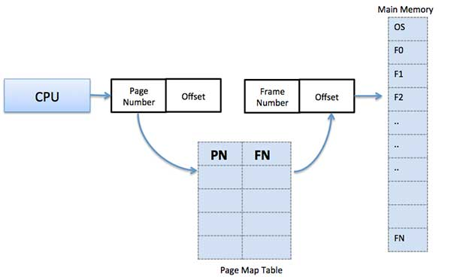
Address Translation
Page address is called logical address and represented by page number and the offset.
Logical Address = Page number + page offset
Frame address is called physical address and represented by a frame number and the offset.
Physical Address = Frame number + page offset
A data structure called page map table is used to keep track of the relation between a page of a process to a frame in physical memory.

Slide 47
When the system allocates a frame to any page, it translates this logical address into a physical address and create entry into the page table to be used throughout execution of the program.
This process continues during the whole execution of the program where the OS keeps removing idle pages from the main memory and write them onto the secondary memory and bring them back when required by the program.

Slide 48
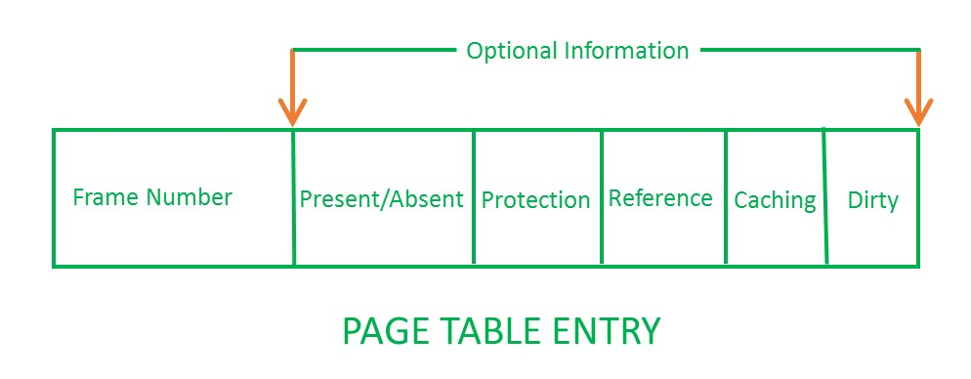
Page Table
Page table has page table entries where each page table entry stores a frame number and optional status (like protection) bits. Many of status bits used in the virtual memory system. The most important thing in PTE is frame Number.
Frame Number : It gives the frame number in which the current page you are looking for is present.
Present/Absent bit :Present or absent bit says whether a particular page you are looking for is present or absent. In case if it is not present, that is called Page Fault. It is set to 0 if the corresponding page is not in memory.
Protection bit :Protection bit says that what kind of protection you want on that page. So, these bit for the protection of the page frame (read, write etc).
Referenced bit: Referenced bit will say whether this page has been referred in the last clock cycle or not. It is set to 1 by hardware when the page is accessed.
Number of bits for frame = Size of physical memory/frame size

Slide 49
Page Table
Caching enabled/disabled :Some times we need the fresh data. Let us say the user is typing some information from the keyboard and your program should run according to the input given by the user. In that case, the information will come into the main memory.
Modified bit : Modified bit says whether the page has been modified or not. Modified means sometimes you might try to write something on to the page. If a page is modified, then whenever you should replace that page with some other page, then the modified information should be kept on the hard disk or it has to be written back or it has to be saved back.

Slide 50
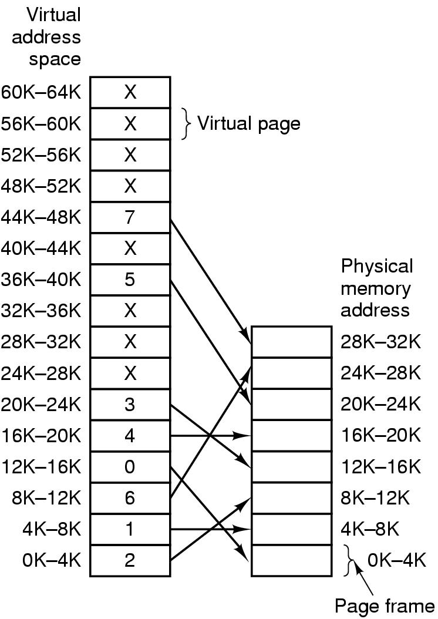
Mapping of pages to page frames
Figure 5-13 : The relation between virtual addresses and physical memory addresses is given by the page table. Every page begins on a multiple of 4096 and ends 4095 addresses higher, so 4K–8K really means 4096–8191 and 8K to 12K means 8192–12287.

Slide 51
Page Table
The page table is used to look up what frame a particular page is stored in at the moment. or
A page table is the data structure used by a virtual memory system in a computer operating system to store the mapping between virtual addresses and physical addresses
Virtual address={virtual page number, offset}
Virtual page number used to index into page table to find page frame number
If present/absent bit is set to 1, attach page frame number to the front of the offset, creating the physical address
which is sent on the memory bus

Slide 52
Page Tables for Large Memories
Multi-level page tables
Want to avoid keeping the entire page table in memory because it is too big
Hierarchy of page tables does this
The hierarchy is a page table of page tables

Slide 53
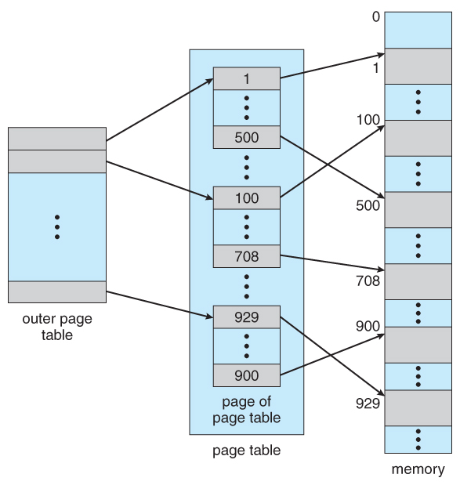

Slide 54
Multilevel Paging is a paging scheme which consist of two or more levels of page tables in a hierarchical manner. It is also known as hierarchical paging. The entries of the level 1 page table are pointers to a level 2 page table and entries of the level 2 page tables are pointers to a level 3 page table and so on. The entries of the last level page table are stores actual frame information. Level 1 contain single page table and address of that table is stored in PTBR (Page Table Base Register).

Slide 55
Inverted Page Tables
Rather than each process having a page table and keeping track of all possible logical pages,
– track all physical pages
One entry for each real page of memory
Entry consists of
– the virtual address of the page stored in that real memory location,
– information about the process that owns that page

Slide 56
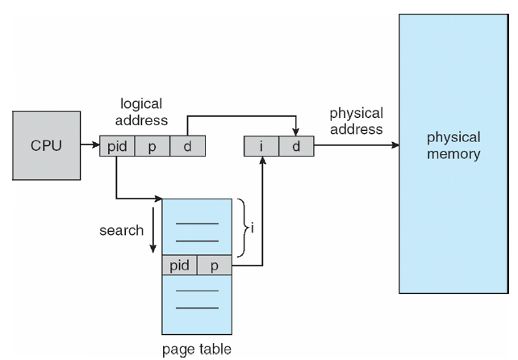
Figure 5-18 : Inverted Page Table

Slide 57
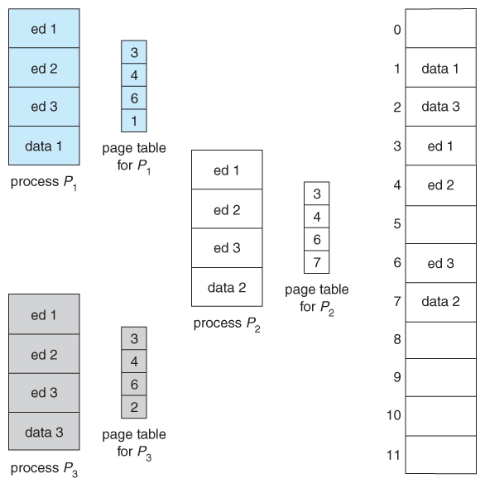
Shared page table
Paging systems can make it very easy to share blocks of memory, by simply duplicating page numbers in multiple page frames. This may be done with either code or data.
In the example given below, three different users are running the editor simultaneously, but the code is only loaded into memory ( in the page frames ) one time.
Some systems also implement shared memory in this fashion.

Slide 58
Page Fault Processing
Present/absent bit tells whether page is in memory
What happens If address is not in memory?
Trap to the OS
OS picks page to write to disk
Brings page with (needed) address into memory
Re-starts instruction

Slide 59
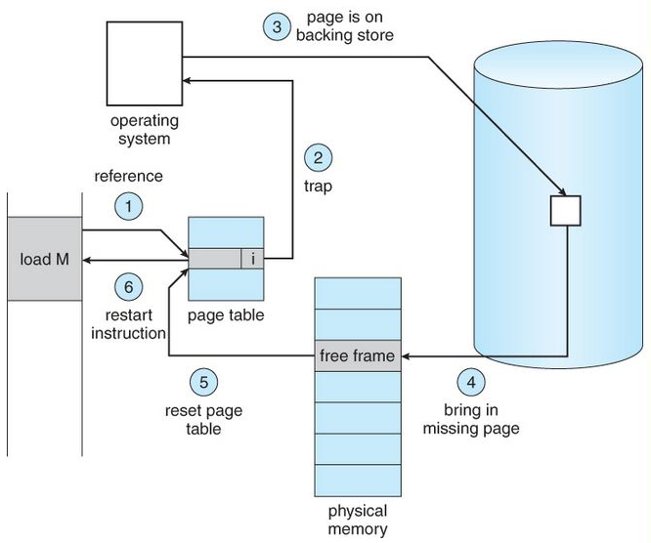
Page Fault Handling in Operating System
A page fault occurs when a program attempts to access data or code that is in its address space, but is not currently located in the system RAM. So when page fault occurs then following sequence of events happens .

Slide 60
Check the location of the referenced page in the PMT
If a page fault occured, call on the operating system to fix it
Using the frame replacement algorithm, find the frame location
Read the data from disk to memory
Update the page map table for the process
The instruction that caused the page fault is restarted when the process resumes execution.

Slide 61
A translation lookaside buffer (TLB) is a memory cache that is used to reduce the time taken to access a user memory location.
It is a part of the chip's memory-management unit (MMU).

Slide 62
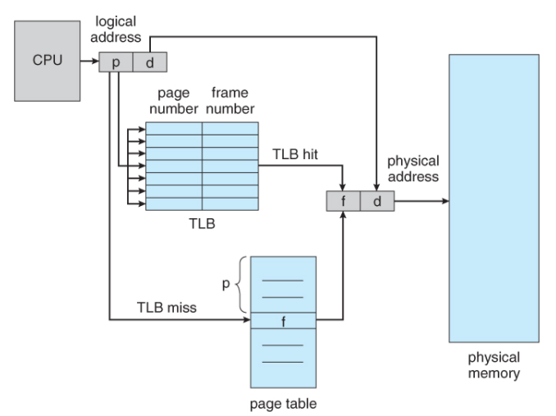
Figure 5-20 :TLB(Translation Look Aside Buffer)

Slide 63
The CPU generates the logical address, which contains the page number and the page offset.
The page number is used to index into the page table, to get the corresponding page frame number, and once we have the page frame of the physical memory(also called main memory), we can apply the page offset to get the right word of memory.
The thing is that page table is stored in physical memory, and sometimes can be very large, so to speed up the translation of logical address to physical address , we use TLB, which is made of expensive and faster associative memory, So instead of going into page table first, we go into the TLB and use page number to index into the TLB.
TLB Miss: If we don't find the page frame number inside the TLB, it is called a TLB miss only then we go to the page table to look for the corresponding page frame number.
TLB Hit: If we find the page frame number in TLB, its called TLB hit, and we don't need to go to page table.

Slide 64
Page Replacement Algorithms
First-in First-Out (FIFO) page replacement
Second chance page replacement
Optimal page replacement
Least Recently Used (LRU) page replacement
Clock page replacement
WSClock page replacement
Not recently used(NRU) page replacement
If a process requests for page and that page is found in the main memory then it is called page hit, otherwise page miss or page fault.

Slide 65
First-in, first-out
The simplest page-replacement algorithm is a FIFO algorithm.
The first-in, first-out (FIFO) page replacement algorithm is a low-overhead algorithm that requires little book-keeping on the part of the operating system.
The idea is obvious from the name - the operating system keeps track of all the pages in memory in a queue, with the most recent arrival at the back, and the earliest arrival in front.
When a page needs to be replaced, the page at the front of the queue (the oldest page) is selected.
–While FIFO is cheap and intuitive, it performs poorly in practical application. Thus, it is rarely used in its unmodified form. This algorithm experiences Belady's anomaly, in which increasing the number of frames available can actually increase the number of page faults that occur.

Slide 66
Example:- Consider the main memory consists of 3 frames for FIFO Page Replacement algorithm and input pattern of memory pages.
7, 0 , 1 , 2 , 0 , 3, 0, 4 , 2 , 3 , 0, 3, 1
* * * * Hit * * * * * * Hit *
Total references=13
Total Page Hits=2 , [ Hit ratio= no. of hits / no. of references=>2/13]
Total Page faults/page miss=11 , [Miss ratio= no. of miss / no. of references=>11/13]
7
7
0
7
0
1
2
0
1
2
0
1
2
3
1
2
3
0
4
3
0
4
2
0
4
2
3
0
2
3
0
2
3
0
1
3

Slide 67
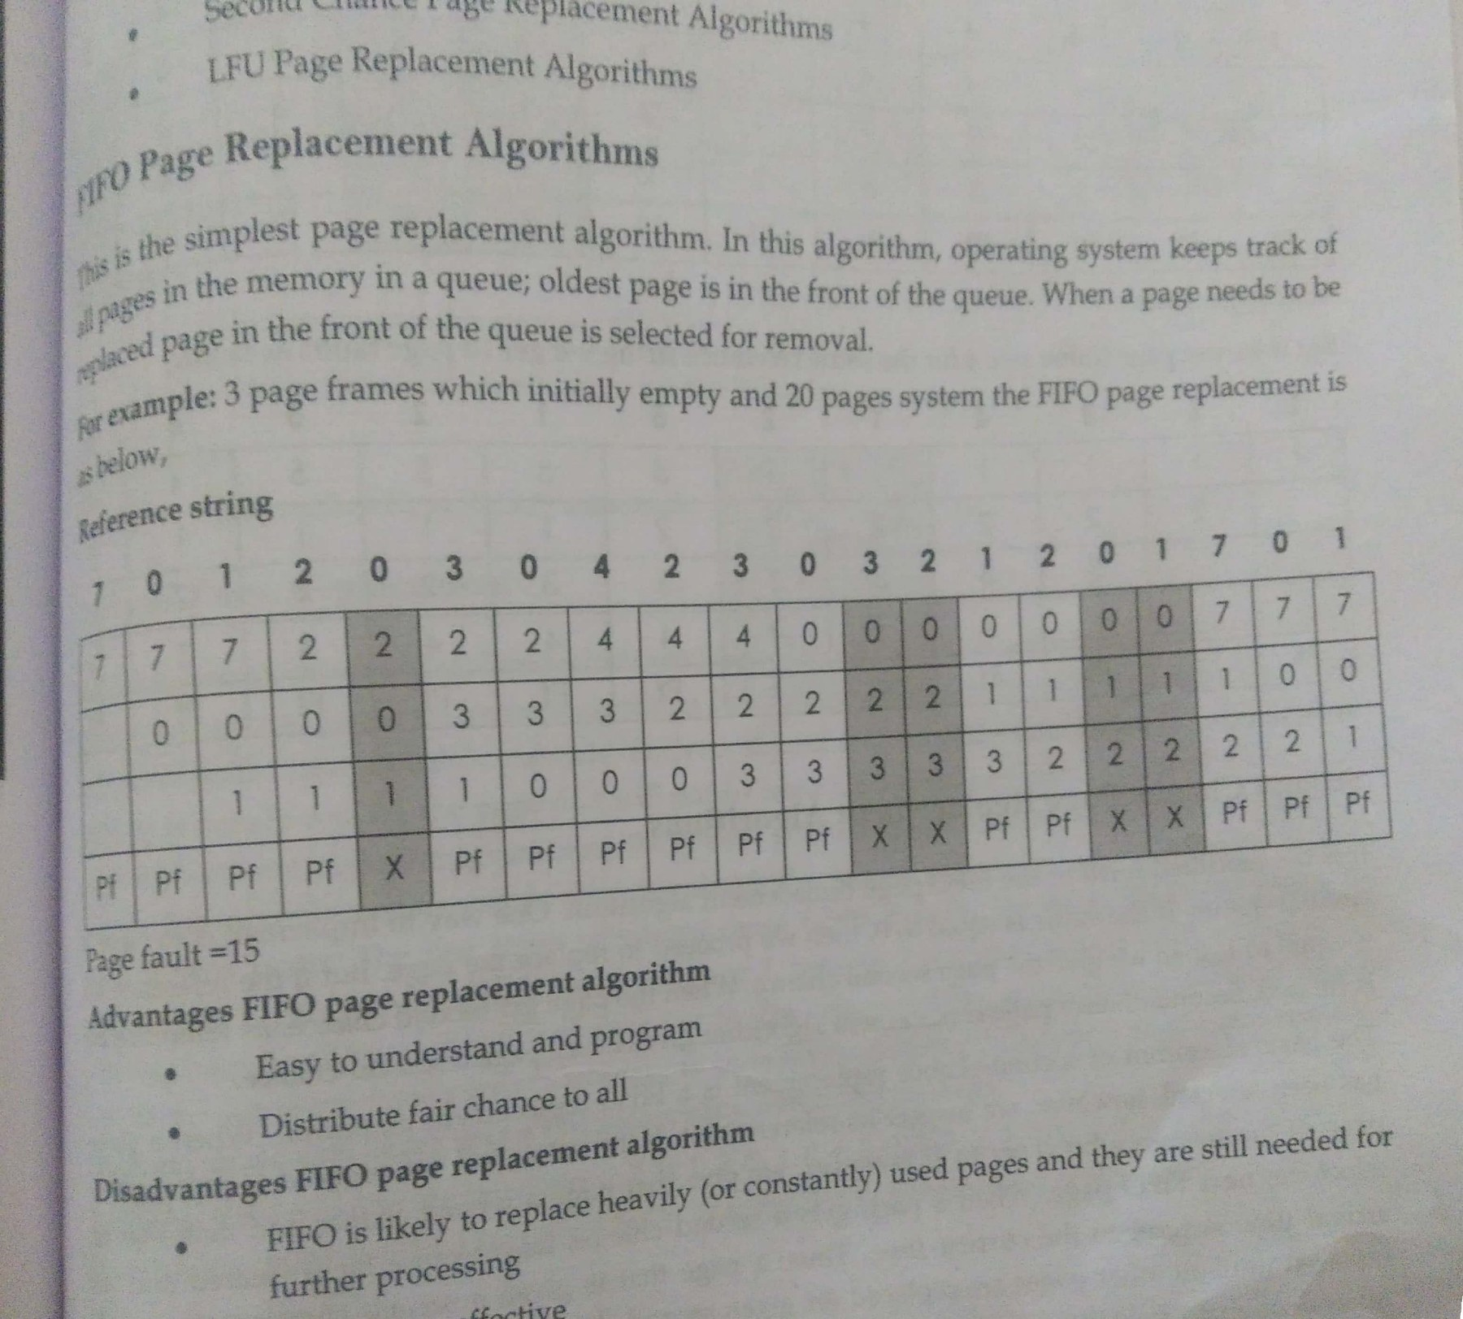

Slide 68
Second Chance
Example:- Consider the main memory consists of 3 frames for Second chance Page Replacement algorithm and input pattern of memory pages.
2, 3, 2, 1, 5, 2, 4, 5, 3, 2, 3, 5
* * H * * H * H * * H H
Total Page faults= 7
Total Page hits=5
2
2
3
2
3
2
3
1
2
5
1
2
5
1
2
5
4
2
5
4
3
5
4
3
5
2
3
5
2
3
5
2

Slide 69
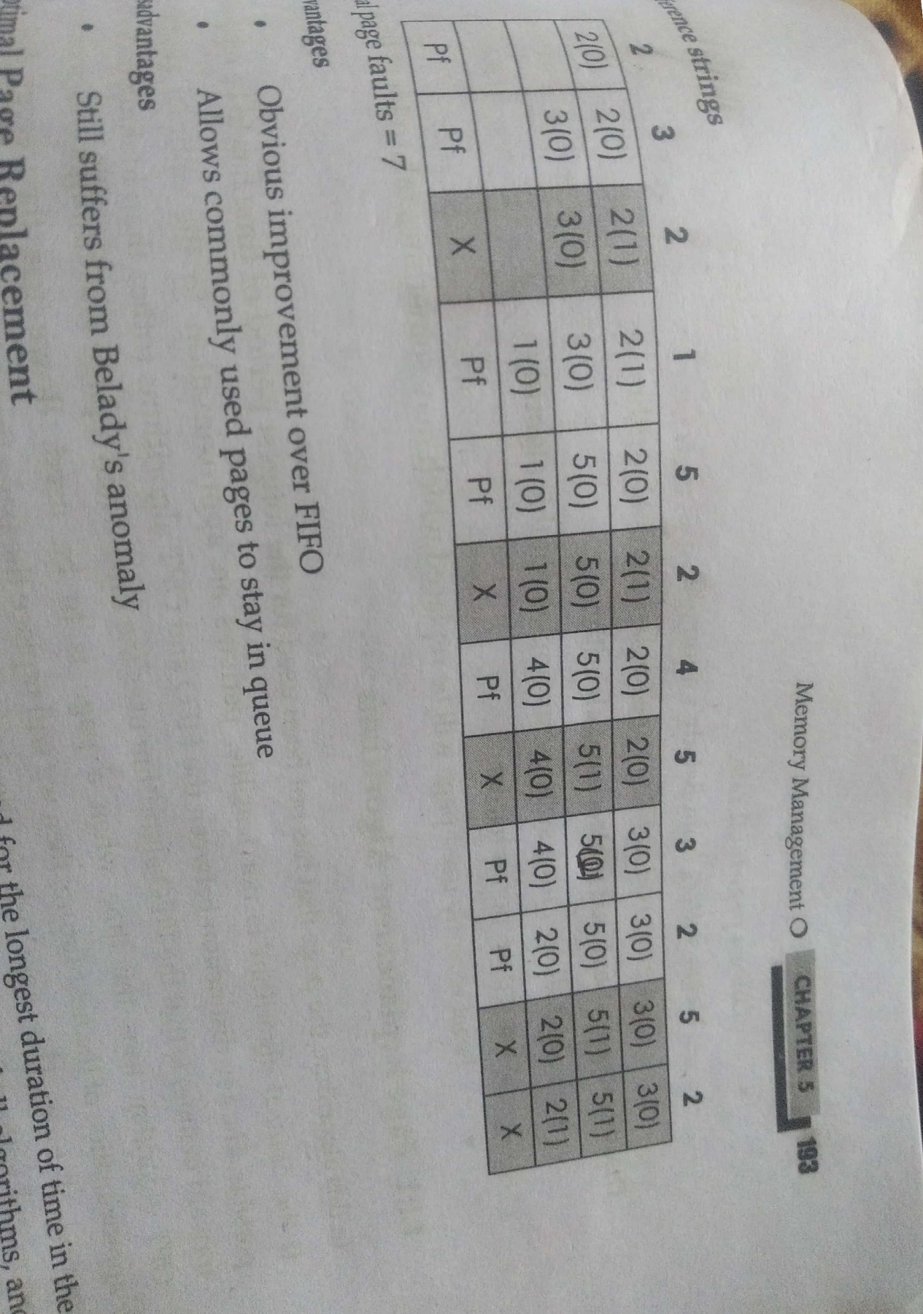

Slide 70
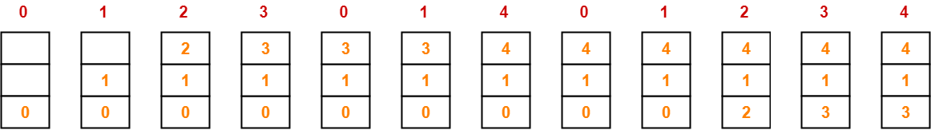
Belady’s Anomaly
Belady’s Anomaly is the phenomenon of increasing the number of page faults on increasing the number of frames in main memory.
Illustration-01: For Optimal Page Replacement Algorithm-
Consider the reference string is 0, 1, 2, 3, 0, 1, 4, 0, 1, 2, 3, 4
When frame size is 3:
Number of page faults = 7
Number of page faults = 7

Slide 71
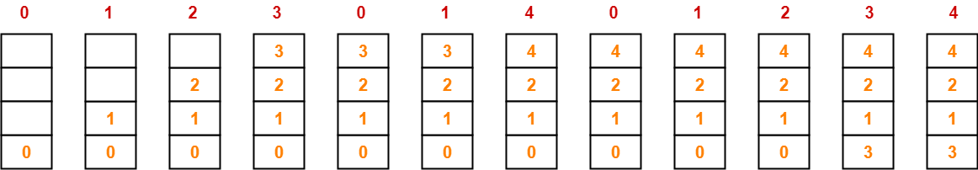
Belady’s Anomaly is the phenomenon of increasing the number of page faults on increasing the number of frames in main memory.
Illustration-01: For Optimal Page Replacement Algorithm-
Consider the reference string is 0, 1, 2, 3, 0, 1, 4, 0, 1, 2, 3, 4
Case-02: When frame size = 4
Total page fault 6

Slide 72
Optimal page replacement(OPT)
The theoretically optimal page replacement algorithm (also known as OPT, clairvoyant replacement algorithm, or Bélády's optimal page replacement policy) is an algorithm that works as follows:
–when a page needs to be swapped in, the operating system swaps out the page whose next use will occur farthest in the future.
–For example, a page that is not going to be used for the next 6 seconds will be swapped out over a page that is going to be used within the next 0.4 seconds.
This algorithm cannot be implemented in the general purpose operating system because it is impossible to compute reliably how long it will be before a page is going to be used, except when all software that will run on a system is either known beforehand and is amenable to the static analysis of its memory reference patterns, or only a class of applications allowing run-time analysis.

Slide 73
Example:- Consider the main memory consists of 3 frames for OPT Page Replacement algorithm and input pattern of memory pages.
1,2,3,4,1,2,5,1,2,3,4,5
* * * * H H * H H * * H
Total page faults=7
Total page Hits=5
1
1
2
1
2
3
1
2
4
1
2
4
1
2
4
1
2
5
1
2
5
1
2
5
3
2
5
3
4
5
3
4
5

Slide 74
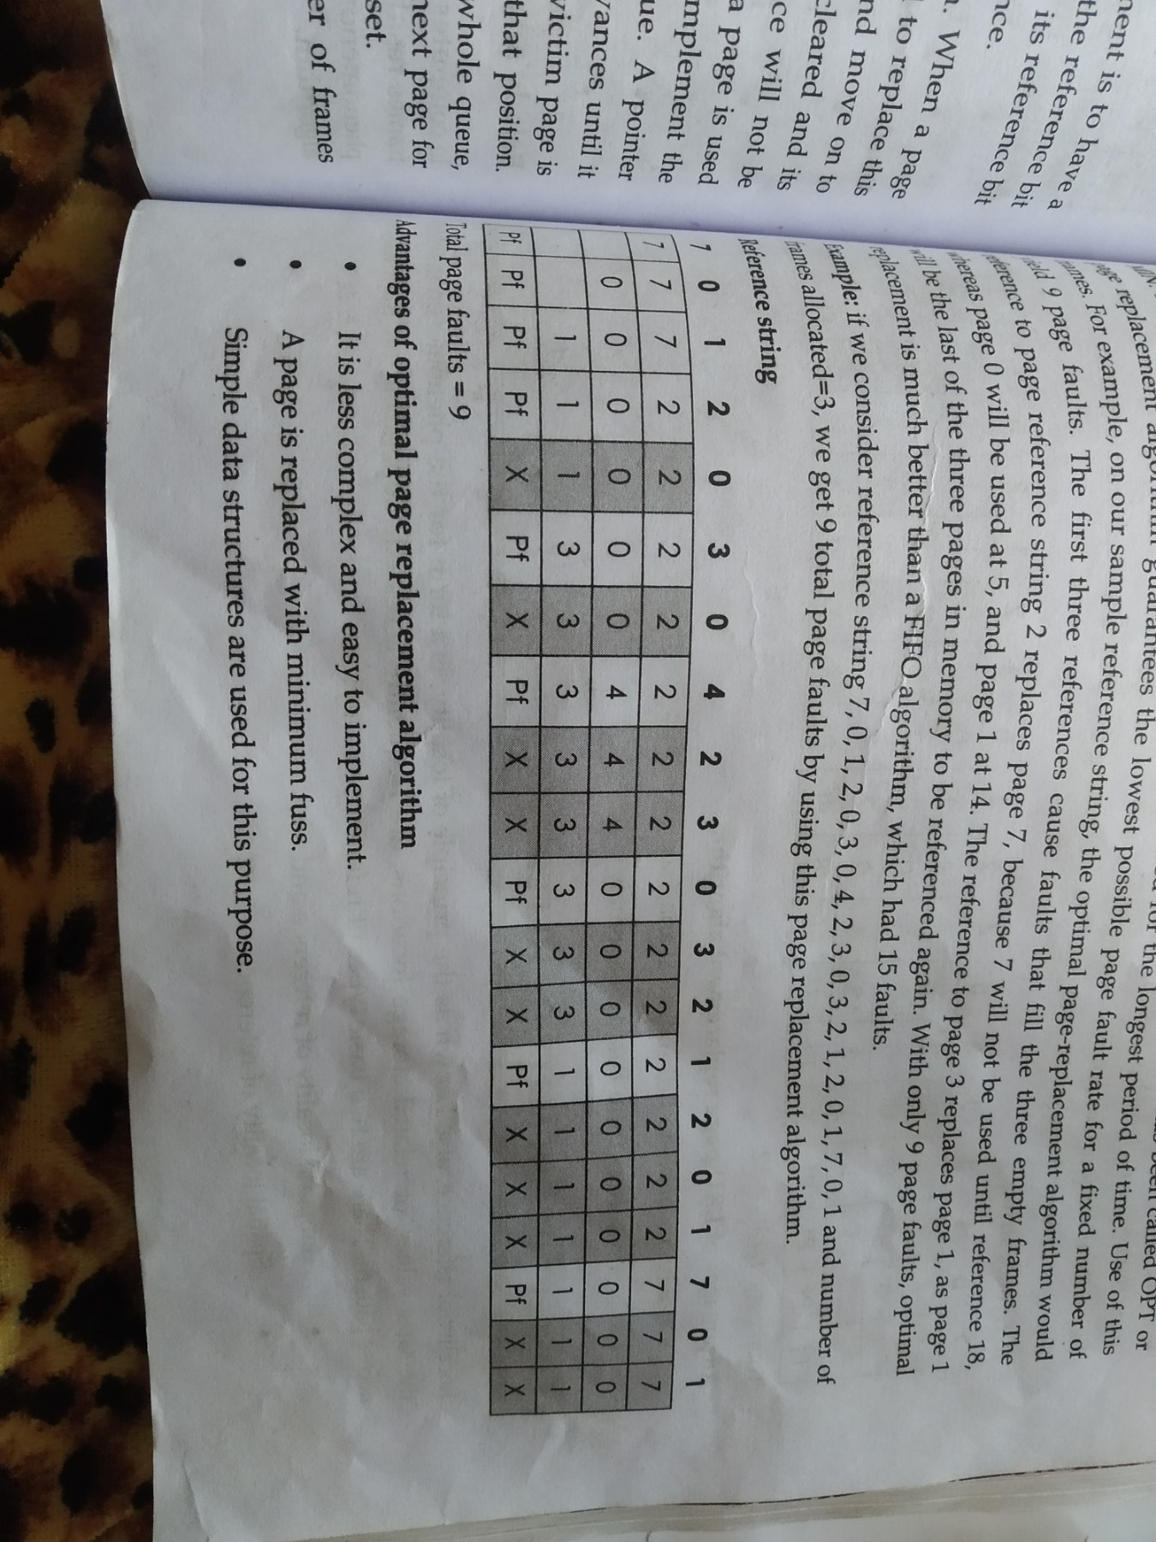

Slide 75
Least Recently Used (LRU)
LRU works on the idea that pages that have been most heavily used in the past few instructions are most likely to be used heavily in the next few instructions too.
While LRU can provide near-optimal performance in theory (almost as good as Adaptive Replacement Cache), it is rather expensive to implement in practice.
There are a few implementation methods for this algorithm that try to reduce the cost yet keep as much of the performance as possible.
The most expensive method is the linked list method, which uses a linked list containing all the pages in memory.
At the back of this list is the least recently used page, and at the front is the most recently used page.

Slide 76
The difficulty is that the list must be updated on every memory reference.
Another method that requires hardware support is as follows: suppose the hardware has a 64-bit counter that is incremented at every instruction.
Whenever a page is accessed, it gains a value equal to the counter at the time of page access.
Whenever a page needs to be replaced, the operating system selects the page with the lowest counter and swaps it out.
With present hardware, this is not feasible because the OS needs to examine the counter for every page in memory.

Slide 77
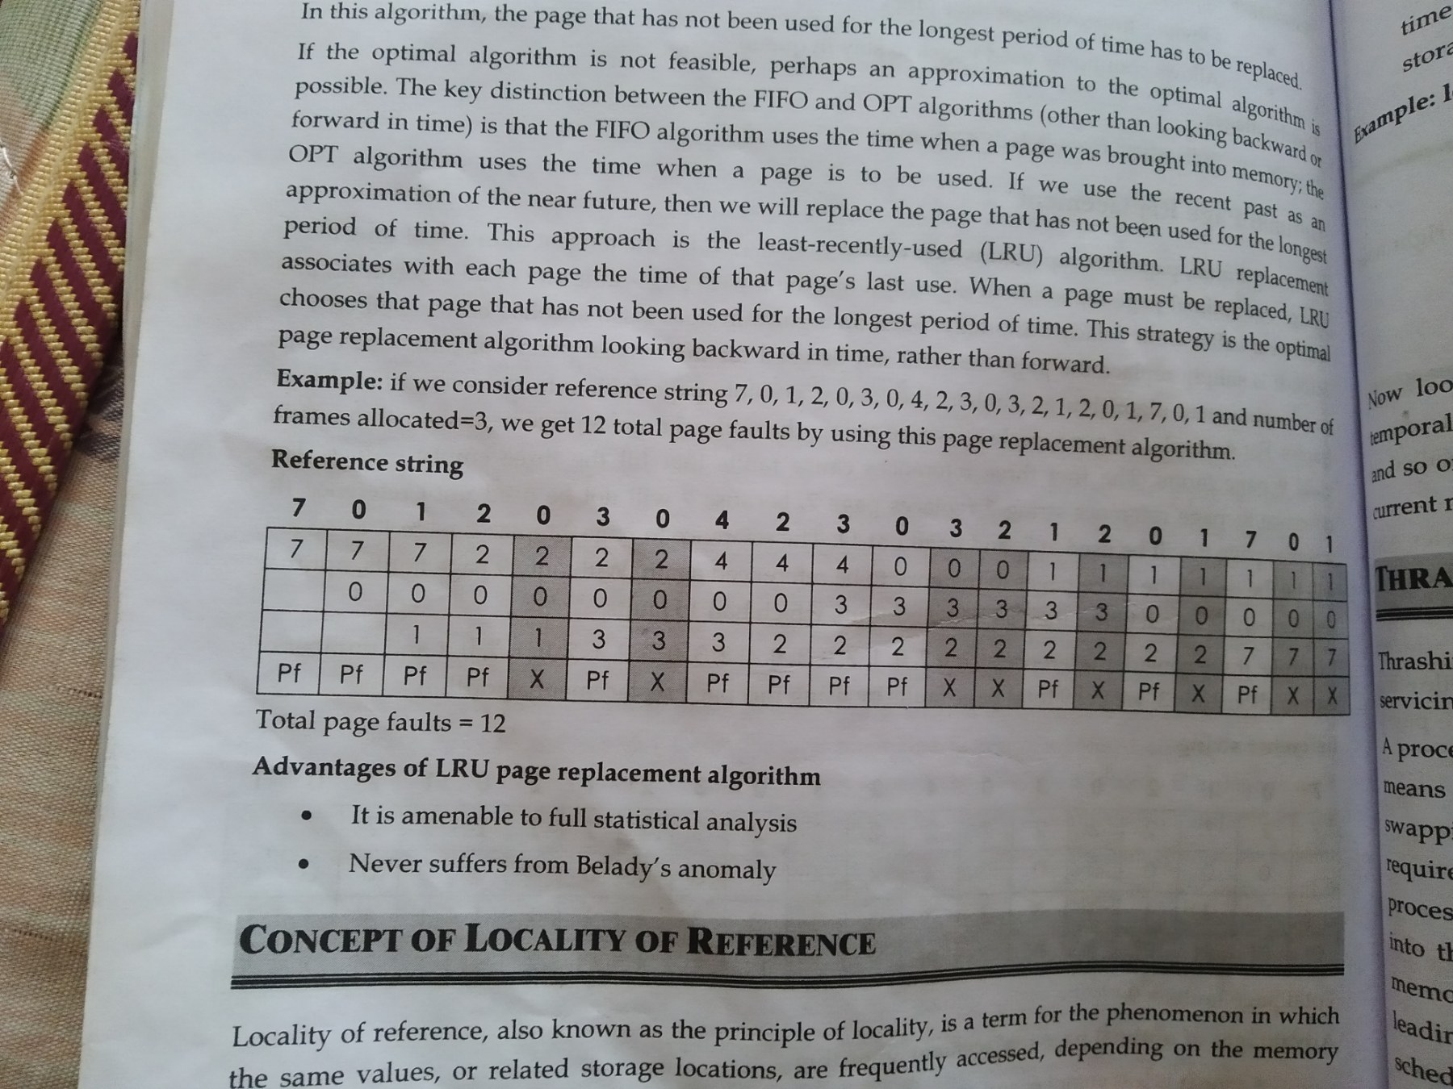

Slide 78
Example:- Consider the main memory consists of 4 frames for LRU Page Replacement algorithm and input pattern of memory pages.
7,0,1,2,0,3,0,4,2,3,0,3,2,1,2,0,1,7,0
* * * * H * H * H H H H H * H H H * H
Page Faults=8
Page Hits=11
7
7
0
7
0
1
7
0
1
2
7
0
1
2
3
0
1
2
3
0
1
2
3
0
4
2
3
0
4
2
3
0
4
2
3
0
4
2
3
0
4
2
3
0
4
2
3
0
1
2
3
0
1
2
3
0
1
2
3
0
1
2
7
0
1
2
7
0
1
2

Slide 79
Locality of Reference
Locality of reference refers to the tendency of the computer program to access the same set of memory locations for a particular time period. The property of Locality of Reference is mainly shown by loops and subroutine calls in a program.
Temporal Locality:
Temporal locality means current data or instruction that is being fetched may be needed soon. So we should store that data or instruction in the cache memory so that we can avoid again searching in main memory for the same data.
Spatial Locality:
Spatial locality means instruction or data near to the current memory location that is being fetched, may be needed soon in the near future. This is slightly different from the temporal locality. Here we are talking about nearly located memory locations while in temporal locality we were talking about the actual memory location that was being fetched

Slide 80
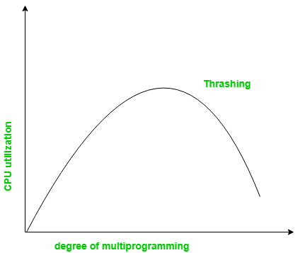
Thrashing
Thrashing is a condition or a situation when the system is spending a major portion of its time in servicing the page faults, but the actual processing done is very negligible.
The basic concept involved is that if a process is allocated too few frames, then there will be too many and too frequent page faults. As a result, no useful work would be done by the CPU and the CPU utilization would fall drastically. The long-term scheduler would then try to improve the CPU utilization by loading some more processes into the memory thereby increasing the degree of multiprogramming.

Slide 81
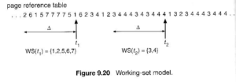
The Working Set Model
The working set model is based on the concept of locality, and defines a working set window, of length delta. Whatever pages are included in the most recent delta page references are said to be in the processes working set window, and comprise its current.
The selection of delta is critical to the success of the working set model – If it is too small then it does not encompass all of the pages of the current locality, and if it is too large, then it encompasses pages that are no longer being frequently accessed.

Slide 82
Segmentation
Segmentation is a memory management technique in which, the memory is divided into the variable size parts. Each part is known as segment which can be allocated to a process.
The details about each segment are stored in a table called as segment table.
For example, a compiler has many tables that are built up as compilation proceeds, possibly including
1. The source text being saved for the printed listing (on batch systems).
2. The symbol table, containing the names and attributes of variables.
3. The table containing all the integer and floating-point constants used.
4. The parse tree, containing the syntactic analysis of the program.
5. The stack used for procedure calls within the compiler.

Slide 83
Consider what happens if a program has an exceptionally large number of variables but a normal amount of everything else.
The chunk of address space allocated for the symbol table may fill up, but there may be lots of room in the other tables.
A straightforward and extremely general solution is to provide the machine with many completely independent address spaces, called segments.
Each segment consists of a linear sequence of addresses, from 0 to some maximum.
Segment table contains mainly two information about segment:
Base: It is the base address of the segment
Limit: It is the length of the segment.

Slide 84
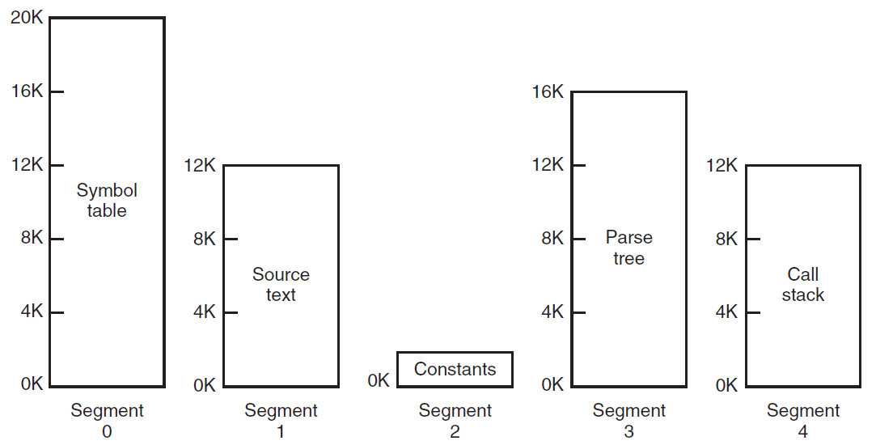
Figure 5-24: A segmented memory allows each table to grow or shrink independently
of the other tables.

Slide 85
Advantages of Segmentation
Advantages of Segmentation –
No Internal fragmentation.
Segment Table consumes less space in comparison to Page table in paging.
Disadvantage of Segmentation –
As processes are loaded and removed from the memory, the free memory space is broken into little pieces, causing External fragmentation.

Slide 86
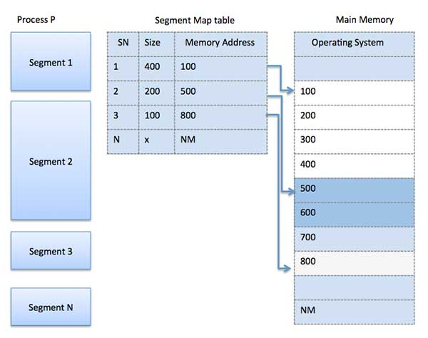

Slide 87
Working-
In segmented paging,
Process is first divided into segments and then each segment is divided into pages.
These pages are then stored in the frames of main memory.
A page table exists for each segment that keeps track of the frames storing the pages of that segment.
Each page table occupies one frame in the main memory.
Number of entries in the page table of a segment = Number of pages that segment is divided.
A segment table exists that keeps track of the frames storing the page tables of segments.
Number of entries in the segment table of a process = Number of segments that process is divided.
The base address of the segment table is stored in the segment table base register.
Segmentation with Paging: MULTICS

Slide 88
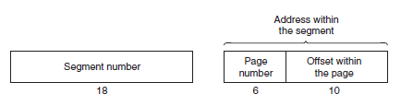
An address in MULTICS consisted of two parts: the segment and the address within the segment. The address within the segment was further divided into a page number and a word within the page.
Segment Number :It points to the appropriate Segment Number.
Page Number: It Points to the exact page within the segment
Page Offset: Used as an offset within the page frame
Figure 5-28: A 34-bit MULTICS virtual address.

Slide 89
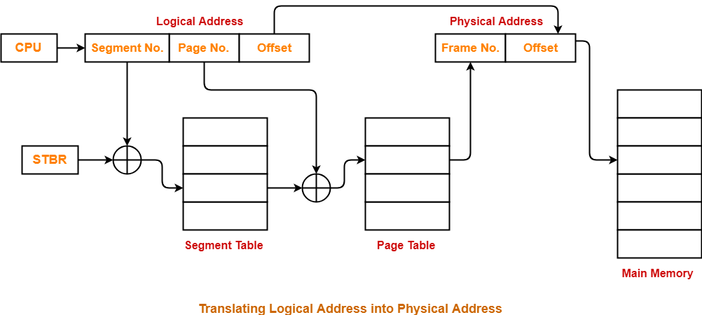

Slide 90
The page field is used as an index into the page table to find the physical address of the page frame.
The offset is added to the address of the page frame to get the physical address of the byte or word needed.

